Slide 1
Molecular Geometry and Bonding Theories
Chapter 8

Slide 2
Section 8.1 Molecular Compounds
Key Concepts:
How are the melting points and boiling points of molecular compounds different from ionic compounds?
What information does a molecular formula provide?

Slide 3
Vocabulary
covalent bond
molecule
diatomic molecule
molecular compound
molecular formula

Slide 4
Molecules and
Molecular Compounds
Key Concept: Molecular compounds tend to have relatively lower melting and boiling points than ionic compounds.
Covalent bond: when two atoms are held together by the sharing of electrons.
Water (H₂O) H – O – H
Carbon Dioxide (CO₂) O = C = O
Molecule: a neutral group of atoms joined together by covalent bonds.
Diatomic Molecule: a molecule consisting of two atoms.
Example: Oxygen molecule (O₂) O = O

Slide 5
Molecules and Molecular Compounds
Key Concept: Molecular compounds tend to have relatively lower melting and boiling points than ionic compounds.
Molecular compound: a compound composed of molecules, and made of different atoms (two or more nonmetals). Water (H₂O) H – O – H
Carbon Dioxide (CO₂) O = C = O

Slide 6
Draw diagrams of ionic and covalent bonds to understand the differences:
Ionic Compound: Salt
Array of sodium ions and chloride ions:
Molecular Compound: Water
Collection of water molecules:
Structure: ???
Chemical Formula: ???
Structure: ???
Chemical Formula: ???

Slide 7
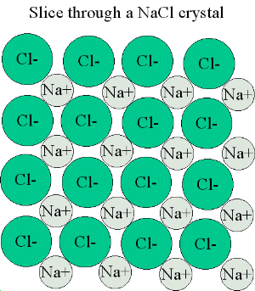
Draw diagrams of ionic and covalent bonds to understand the differences:
Ionic Compound: Salt
Array of sodium ions and chloride ions:
Molecular Compound: Water
Collection of water molecules:
Structure: Na⁺ Cl⁻
Chemical Formula: NaCl
Structure: H – O – H
Chemical Formula: H₂O

Slide 8
Molecular Formulas
Key Concept: A Molecular formula shows how many atoms of each element a molecule contains.
Molecular formula: the chemical formula of a molecular compound.
Water
Carbon dioxide
Ammonia (NH₃)
Ethane (C₂H₆)
*Refer to page: 216

Slide 9
Practice
Write the electron dot structures of the following molecules:
BF₃ (boron trifluoride)
CH₄ (methane)
SF₄ (sulfur tetrafluoride)
CO (carbon monoxide)
BeCl₂ (beryllium dichloride)
*Refer to page: 216

Slide 10
Sections 8.2 – 8.3 Bonding Theories
Key Concepts:
What is the VSEPR Theory?
How does the VSEPR Theory predict the shape of molecules?

Slide 11
H
H
CH₄
H
C
H
109.5º
C
H
H
H
H
molecular
formula
structural
formula
molecular
shape
H
C
H
H
H
tetrahedral
shape of
methane
tetrahedron
ball-and-stick
model

Slide 12
Methane & Carbon Tetrachloride
molecular
formula
structural
formula
molecular
shape
ball-and-stick
model
H
H
CH₄
H
C
H
109.5º
C
H
H
H
H
Cl
CCl₄
Cl
C
Cl
Cl
space-filling model
Notes:
The molecular geometry is predicted by first writing the Lewis structure, then using the VSEPR model to determine the electron-domain geometry, and finally focusing on the atoms themselves to describe the molecular structure.

Slide 13
Molecular Geometry
180º
H
109.5º
109.5º
C
H
H
Linear
Trigonal planar
H
Tetrahedral
104.5º
107.3º
Bent
Trigonal pyramidal
H₂O CH₄ AsCl₃ AsF₅ BeH₂ BF₃ CO₂

Slide 14
H
..
..
C
N
O
H
H
H
H
..
H
109.5º
107º
104.5º
H
H
H
CH₄, methane
NH₃, ammonia
H₂O, water
..
lone pair
electrons
O
O
O
O
O
O
O₃, ozone

Slide 15
Molecular Shapes
Three atoms (AB₂)
Four atoms (AB₃)
B
Linear (180º)
Bent
Trigonal planar (120º)
Trigonal pyramidal
T-shaped
A
B
A
B
B
B
linear
trigonal planar
B
Five atoms (AB₄)
Tetrahedral (109.47º)
Square planar
Seesaw
tetrahedral
A
B
Bª
B
Six atoms (AB₅)
B
B^{e}
Trigonal bipyramidal (B^{e}AB^{e}, 120º) & (B^{e}ABª, 90º)
Square pyramidal
A
B^{e}
B
B^{e}
Seven atoms (AB₆)
B
B
Trigonal
bipyramidal
A
Bª
Octahedral
B
B
Bailar, Moeller, Kleinberg, Guss, Castellion, Metz, Chemistry, 1984, page 313.
B

Slide 16
Bonding and Shape of Molecules
Number
of Bonds
Number of
Unshared Pairs
Covalent
Structure
Shape
Examples
2
3
4
3
2
0
0
0
1
2
-Be-
Linear
Trigonal planar
Tetrahedral
Pyramidal
Bent
BeCl₂
BF₃
CH₄, SiCl₄
NH₃, PCl₃
H₂O, H₂S, SCl₂
B
C
:
N
:
:
O

Slide 17
Molecular Shapes
AB₂
Linear
AB₃
Trigonal planar
AB₃E
Angular or Bent
AB₄
Tetrahedral
AB₃E
Trigonal
pyramidal
AB₃E₂
Angular
or Bent
AB₅
Trigonal bipyramidal
AB₄E
Irregular tetrahedral
(see saw)
AB₃E₂
T-shaped
AB₂E₃
Linear
AB₆
Octahedral
AB₆E
Square pyramidal
AB₅E₂
Square planar

Slide 18
The VSEPR Model
The Shapes of Some Simple AB_{n} Molecules
..
..
..
SO₂
O
S
N
C
F
O
O
O
O
S
F
F
O
O
Linear
Bent
Trigonal
planar
Trigonal
pyramidal
SF₆
F
F
F
F
F
F
F
F
Xe
P
F
S
F
Cl
F
F
F
F
F
F
T-shaped
Square
planar
F
F
Trigonal
bipyramidal
Octahedral
Brown, LeMay, Bursten, Chemistry The Central Science, 2000, page 305
Notes:
Students often confuse electron-domain geometry with molecular geometry.
You must stress that the molecular geometry is a consequence of the electron domain geometry.
The best arrangement of a given number of electron domains is the one that minimizes the repulsions among them.

Slide 19
Molecular Shapes
AB₂
Linear
AB₃
Trigonal planar
AB₂E
Angular or Bent
AB₄
Tetrahedral
AB₃E
Trigonal
pyramidal
AB₂E₂
Angular
or Bent
AB₅
Trigonal bipyramidal
AB₄E
Irregular tetrahedral
(see saw)
AB₃E₂
T-shaped
AB₂E₃
Linear
AB₆
Octahedral
AB₅E
Square pyramidal
AB₄E₂
Square planar
Notes:
(Source: R.J. Gillespie, J. Chem. Educ., 40, 295, 1963.)

Slide 20
Geometry of Covalent Molecules AB_{n}, and AB_{n}E_{m}
Shared
Electron
Pairs
Unshared
Electron
Pairs
Type
Formula
Ideal
Geometry
Observed
Molecular Shape
Examples
AB₂
AB₂E
AB₂E₂
AB₂E₃
AB₃
AB₃E
AB₃E₂
AB₄
AB₄E
AB₄E₂
AB₅
AB₅E
AB₆
2
2
2
2
3
3
3
4
4
4
5
5
6
0
1
2
3
0
1
2
0
1
2
0
1
0
Linear
Trigonal planar
Tetrahedral
Trigonal bipyramidal
Trigonal planar
Tetrahedral
Triangular bipyramidal
Tetrahedral
Triangular bipyramidal
Octahedral
Triangular bipyramidal
Octahedral
Octahedral
Linear
Angular, or bent
Angular, or bent
Linear
Trigonal planar
Triangular pyramidal
T-shaped
Tetrahedral
Irregular tetrahedral
(or “see-saw”)
Square planar
Triangular bipyramidal
Square pyramidal
Octahedral
CdBr₂
SnCl₂, PbI₂
OH₂, OF₂, SCl₂, TeI₂
XeF₂
BCl₃, BF₃, GaI₃
NH₃, NF₃, PCl₃, AsBr₃
ClF₃, BrF₃
CH₄, SiCl₄, SnBr₄, ZrI₄
SF₄, SeCl₄, TeBr₄
XeF₄
PF₅, PCl₅(g), SbF₅
ClF₃, BrF₃, IF₅
SF₆, SeF₆, Te(OH)₆,
MoF₆
Bailar, Moeller, Kleinberg, Guss, Castellion, Metz, Chemistry, 1984, page 317.

Slide 21
Molecules with Expanded Valence Shells
Atoms that have expanded octets have AB₅ (trigonal bipyramidal)
or AB₆ (octahedral) electron domain geometries.
Trigonal bipyramidal structures have a plane containing three electron pairs.
The fourth and fifth electron pairs are located
above and below this plane.
In this structure two trigonal pyramids share a base.
F
F
P
F
F
F
For octahedral structures, there is a plane containing four electron pairs.
F
Similarly, the fifth and sixth electron pairs are located
above and below this plane.
Two square pyramids share a base.
F
F
S
F
F
F

Slide 22
Trigonal Bipyramid
F
F
P
F
F
The three electron pairs in the plane are called equatorial.
The two electron pairs above and below this plane are called axial.
The axial electron pairs are 180º apart and 90º from to the equatorial electrons.
The equatorial electron pairs are 120º apart.
To minimize electron-electron repulsions, nonbonding pairs are always placed
in equatorial positions, and bonding pairs in either axial or equatorial positions.
F

Slide 23
Octahedron
F
F
F
S
The four electron pairs in the plane are 90º to each other.
The remaining two electron pairs are 180º apart and 90º
from the electrons in the plane.
Because of the symmetry of the system, each position is equivalent.
The equatorial electron pairs are 120º apart.
If we have five bonding pairs and one nonbonding pair, it doesn’t matter
where the nonbonding pair is placed.
The molecular geometry is square pyramidal.
If two nonbonding pairs are present, the repulsions are minimized by pointing
them toward opposite sides of the octahedron.
The molecular geometry is square planar.
F
F
F
F
F
Xe
F
F

Slide 24
Electron-Domain Geometries
Number of
Electron Domains
Arrangement of
Electron Domains
Electron-Domain
Geometry
Predicted
Bond Angles
2
3
4
5
6
B
A
B
Linear
Trigonal
planar
Tetrahedral
Trigonal-
bipyramidal
Octahedral
180º
120º
109.5º
120º
90º
90º
B
A
B
B
B
Bª
A
B
B
B^{e}
B
B
A
B^{e}
B
A
B
B^{e}
B
B
B
Bª

Slide 25
Acetic Acid, CH₃COOH
H
O
H
C
C
O
H
H
Number of electron domains
4
3
4
Trigonal
planar
Electron-domain geometry
Tetrahedral
Tetrahedral
Predicted bond angles
109.5º
120º
109.5º
Hybridization of central atom
sp³
sp²
none
Brown, LeMay, Bursten, Chemistry The Central Science, 2000, page 314

Slide 26
Section 8.4 Molecular Polarity
Key Concepts
How do molecules become polarized/charged?
What is a dipole-moment?
What do network solids have high melting points?
Courtesy Christy Johannesson www.nisd.net/communicationsarts/pages/chem

Slide 27
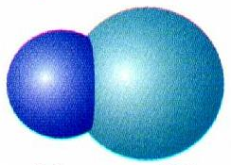
Dipole Moment
Direction of the polar bond in a molecule.
Arrow points toward the more electronegative atom.
δ⁺
δ⁻
H Cl
Courtesy Christy Johannesson www.nisd.net/communicationsarts/pages/chem

Slide 28
Determining Molecular Polarity
Depends on:
dipole moments
molecular shape
Courtesy Christy Johannesson www.nisd.net/communicationsarts/pages/chem

Slide 29
Determining Molecular Polarity
Nonpolar Molecules
Dipole moments are symmetrical and cancel out.
F
BF₃
B
F
F
Courtesy Christy Johannesson www.nisd.net/communicationsarts/pages/chem

Slide 30
Determining Molecular Polarity
Polar Molecules
Dipole moments are asymmetrical and don’t cancel .
O
net
dipole
moment
H₂O
H
H
Courtesy Christy Johannesson www.nisd.net/communicationsarts/pages/chem

Slide 31
Determining Molecular Polarity
Therefore, polar molecules have...
asymmetrical shape (lone pairs) or
asymmetrical atoms
H
net
dipole
moment
CHCl₃
Cl
Cl
Cl
Courtesy Christy Johannesson www.nisd.net/communicationsarts/pages/chem

Slide 32
Dipole Moment
Bond dipoles
In H₂O the bond dipoles are also equal in
magnitude but do not exactly oppose each
other. The molecule has a nonzero overall
dipole moment.
O
C
O
..
..
Overall dipole moment = 0
O
Bond dipoles
Nonpolar
H
H
The overall dipole moment of a molecule
is the sum of its bond dipoles. In CO₂ the
bond dipoles are equal in magnitude but
exactly opposite each other. The overall
dipole moment is zero.
μ = Q r
Overall dipole moment
Dipole moment, μ
Coulomb’s law
Polar
Brown, LeMay, Bursten, Chemistry The Central Science, 2000, page 315

Slide 33
Polar Bonds
..
..
..
F
O
N
Cl
H
H
H
H
B
H
H
F
F
Polar
Polar
Nonpolar
Polar
Cl
Cl
F
F
F
Xe
Cl
C
H
C
F
Cl
F
Cl
H
F
F
Cl
H
Polar
Nonpolar
Nonpolar
Polar
A molecule has a zero dipole moment because their dipoles cancel one another.
Notes:
Students often confuse electron-domain geometry with molecular geometry.
You must stress that the molecular geometry is a consequence of the electron domain geometry.
The best arrangement of a given number of electron domains is the one that minimizes the repulsions among them.

Slide 34
Hydrogen Bond Formation
Potential Energy Diagram - Attraction vs. Repulsion
0
balanced attraction
& repulsion
no interaction
Energy (KJ/mol)
increased
attraction
increased
repulsion
- 436
0.74 A
H – H distance
(internuclear distance)
Brown, LeMay, Bursten, Chemistry The Central Science, 2000, page 318
Notes:
The change in potential energy during the formation of hydrogen molecule. The minimum energy, at 0.74 angstrom, represents the equilibrium bond distance.
The energy at this point, -426 kJ/mol, corresponds to the energy change for formation of the H – H bond.
Potential energy is based on the position of an object. Low potential energy = high stability.

Slide 35
First, the formation of BeH₂ using pure s and p orbitals.
Be = 1s²2s²
H
Be
BeH₂
p
H
s
No overlap = no bond!
atomic orbitals
atomic orbitals
The formation of BeH₂ using hybridized orbitals.
atomic orbitals
Be
H
H
Be
H
s
p
hybrid orbitals
H
BeH₂
Be
Be
s
p
sp
p
All hybridized bonds have equal strength and have orbitals with identical energies.

Slide 36
Hybrid Orbitals
Ground-state Be atom
1s
2s
2p
Be atom with one electron “promoted”
1s
2s
2p
hybrid orbitals
Energy
p_{x}
p_{y}
p_{z}
n = 2
1s
sp
2p
sp
s
Be atom of BeH₂ orbital diagram
n = 1
hybridize
Be
H
H
s orbital
p orbital
two sp hybrid orbitals
sp hybrid orbitals shown together
(large lobes only)

Slide 37
Hybrid Orbitals
Ground-state B atom
2s
2p
B atom with one electron “promoted”
2s
2p
hybrid orbitals
Energy
p_{x}
p_{y}
p_{z}
sp²
2p
sp²
B atom of BH₃ orbital diagram
s
H
hybridize
B
s orbital
H
H
p orbitals
three sp^{s} hybrid orbitals
sp² hybrid orbitals shown together
(large lobes only)

Slide 38
Carbon 1s²2s²2p²
Carbon could only make two bonds
if no hybridization occurs. However,
carbon can make four equivalent bonds.
B
B
A
B
hybrid orbitals
B
Energy
p_{x}
p_{y}
p_{z}
sp³
sp³
s
C atom of CH₄ orbital diagram
Brown, LeMay, Bursten, Chemistry The Central Science, 2000, page 321

Slide 39
Hybridization Involving d Orbitals
promote
3s 3p 3d 3s 3p 3d
unhybridized P atom
P = [Ne]3s²3p³
vacant d orbitals
hybridize
Bª
F
F
B^{e}
five sp³d orbitals
3d
P
F
A
B^{e}
F
B^{e}
degenerate
orbitals
(all EQUAL)
F
Bª
Trigonal bipyramidal

Slide 40
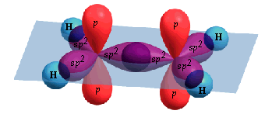
Multiple Bonds
promote
hybridize
2s 2p 2s 2p sp² 2p
C₂H₄, ethene
H
H
C
C
H
H
one σ bond and one π bond
H
H
σ
C
σ
H
H
σ
C
C
H
σ
σ
C
H
H
Two lobes of
one π bond
H
Brown, LeMay, Bursten, Chemistry The Central Science, 2000, page 325-326

Slide 41
Multiple Bonds
C
C
promote
hybridize
2s 2p 2s 2p sp² 2p
C₂H₄, ethene
H
H
H
p
p
H
sp²
C
C
sp²
sp²
sp²
H
sp²
sp²
H
H
p
p
H
one σ bond and one π bond
H
H
σ
C
σ
H
H
σ
C
C
H
σ
σ
C
H
H
Two lobes of
one π bond
H
Brown, LeMay, Bursten, Chemistry The Central Science, 2000, page 325-326

Slide 42
π bond
Internuclear axis
p
p

Slide 43
Brown, LeMay, Bursten, Chemistry The Central Science, 2000, page 326

Slide 44
σ bonds
H
H
C
C
H
C
C
H
C
C
H
H
C₆H₆ = benzene
Brown, LeMay, Bursten, Chemistry The Central Science, 2000, page 329

Slide 45
2p atomic orbitals
Brown, LeMay, Bursten, Chemistry The Central Science, 2000, page 329

Slide 46
σ bonds and π bonds
H
H
C
C
H
C
C
H
C
C
H
H
Brown, LeMay, Bursten, Chemistry The Central Science, 2000, page 329

Slide 47
σ bonds
H
H
C
C
H
H
C
C
C
C
H
H
C
C
H
H
Brown, LeMay, Bursten, Chemistry The Central Science, 2000, page 329

Slide 48
σ bonds
H
H
C
C
H
H
C
C
C
C
H
H
C
C
H
H
Brown, LeMay, Bursten, Chemistry The Central Science, 2000, page 329

Slide 49
N₂O₄
hν
2 NO₂
dinitrogen tetraoxide
nitrogen dioxide
(free radical)
O
O
O
O
N
N
N
N
O
O
O
O
colorless
red-brown

Slide 50
Energy-level diagram for (a) the H₂ molecule and (b) the hypothetical He₂ molecule
(a)
σ∗_{1s}
1s
1s
Energy
H atom
H atom
σ_{1s}
H₂ molecule
(b)
σ∗_{1s}
1s
1s
Energy
He atom
He atom
σ_{1s}
He₂ molecule
Brown, LeMay, Bursten, Chemistry The Central Science, 2000, page 332

Slide 51
Bond Order
Bond order = ½ (# or bonding electrons - # of antibonding electrons)
A bond order of 1 represents a single bond,
A bond order of 2 represents a double bond,
A bond order of 3 represents a triple bond.
A bond order of 0 means no bond exists.
Because MO theory also treats molecules with an odd number of electrons,
Bond orders of 1/2 , 3/2 , or 5/2 are possible.

Slide 52
Energy-level diagram for the Li₂ molecule
σ∗_{2s}
Li = 1s²2s¹
2s¹
2s¹
Energy
σ_{2s}
σ∗_{1s}
1s²
1s²
Li
Li
σ_{1s}
Li²
Brown, LeMay, Bursten, Chemistry The Central Science, 2000, page 334

Slide 53
Energy-level diagram for molecular orbitals
of second-row homonuclear diatomic molecules.
σ∗_{2p}
π∗_{2p}
2p
2p
π_{2p}
σ_{2p}
σ∗_{2s}
2s
2s
σ_{2s}
Brown, LeMay, Bursten, Chemistry The Central Science, 2000, page 337

Slide 54
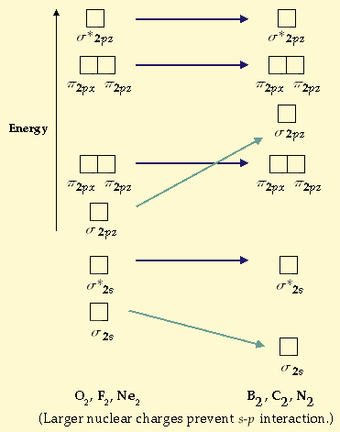
Brown, LeMay, Bursten, Chemistry The Central Science, 2000, page 338

Slide 55
Increasing 2s – 2p interaction
π2p
Energy of
molecular orbitals
σ2p
σ∗2s
σ2s
O₂, F₂, Ne₂
B₂, C₂, N₂
Brown, LeMay, Bursten, Chemistry The Central Science, 2000, page 338

Slide 56
Large 2s – 2p interaction
Small 2s – 2p interaction
B₂
C₂
N₂
O₂
F₂
Ne₂
σ∗_{2p}
σ∗_{2p}
π∗_{2p}
π∗_{2p}
σ_{2p}
π_{2p}
π_{2p}
σ_{2p}
σ∗_{2s}
σ∗_{2s}
σ_{2s}
σ_{2s}
Bond order
Bond enthalpy
(kJ/mol)
Bond length
(angstrom)
Magnetic
behavior
1 2 3 2 1 0
290 620 941 495 155 -----
1.59 1.31 1.10 1.21 1.43 -----
Paramagnetic Diamagnetic Diamagnetic Paramagnetic Diamagnetic _____
Brown, LeMay, Bursten, Chemistry The Central Science, 2000, page 339

Slide 57
Magnetic Properties of a Sample
PARAMAGNETISM
– molecules with one or more unpaired electrons are attracted
into a magnetic field. (appears to weigh MORE in a magnetic field)
DIAMAGNETISM
– substances with no unpaired electrons are weakly repelled from
a magnetic field. (appears to weigh LESS in a magnetic field)

Slide 58
Experiment for determining the magnetic properties of a sample
sample
N
S
N
S
N
S
The sample is first weighed in
the absence of a magnetic field.
When a field is applied, a diamagnetic
sample tends to move out of the field
and appears to have a lower mass.
A paramagnetic sample is drawn
into the field and thus appears to
gain mass.
Paramagnetism is a much stronger effect than is diamagnetism.
Brown, LeMay, Bursten, Chemistry The Central Science, 2000, page 339

Slide 59
Experiment for determining the magnetic properties of a sample
sample
N
S
N
S
The sample is first weighed in
the absence of a magnetic field.
When a field is applied, a diamagnetic
sample tends to move out of the field
and appears to have a lower mass.
A paramagnetic sample is drawn
into the field and thus appears to
gain mass.
Paramagnetism is a much stronger effect than is diamagnetism.
Brown, LeMay, Bursten, Chemistry The Central Science, 2000, page 339

Slide 60
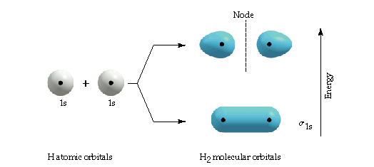

Slide 61
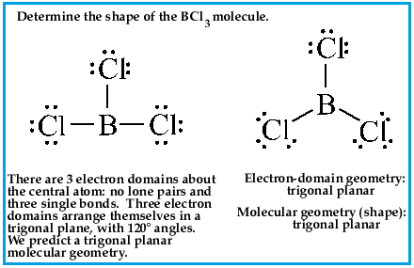

Slide 62
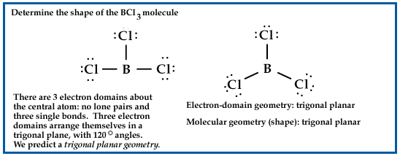
Electron Domains
Lone Pair Single bond Double bond Triple bond

Slide 63
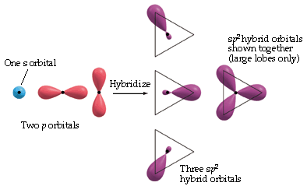

Slide 64
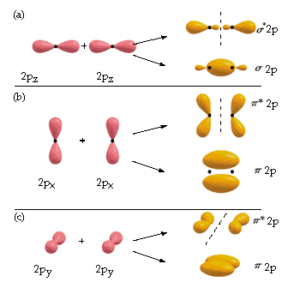

Slide 66
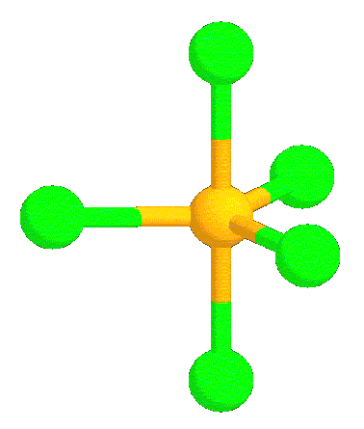
Review: Molecular Geometry
Courtesy Christy Johannesson www.nisd.net/communicationsarts/pages/chem

Slide 67
VSEPR Theory
Valence Shell Electron Pair Repulsion Theory
Electron pairs orient themselves in order to minimize repulsive forces.
Courtesy Christy Johannesson www.nisd.net/communicationsarts/pages/chem

Slide 68
VSEPR Theory
Types of e⁻ Pairs
Bonding pairs - form bonds
Lone pairs - nonbonding electrons
Lone pairs repel more strongly than bonding pairs!!!
Courtesy Christy Johannesson www.nisd.net/communicationsarts/pages/chem

Slide 69
VSEPR Theory
Lone pairs reduce the bond angle between atoms.
Bond Angle
Courtesy Christy Johannesson www.nisd.net/communicationsarts/pages/chem

Slide 70
Determining Molecular Shape
Draw the Lewis Diagram.
Tally up e⁻ pairs on central atom.
- double/triple bonds = ONE pair
Shape is determined by the # of bonding pairs and lone pairs.
Know the 7 common shapes
& their bond angles!
Courtesy Christy Johannesson www.nisd.net/communicationsarts/pages/chem

Slide 71
Common Molecular Shapes
2 total
2 bond
0 lone
B
A
B
LINEAR
180°
BeH₂
Courtesy Christy Johannesson www.nisd.net/communicationsarts/pages/chem

Slide 72
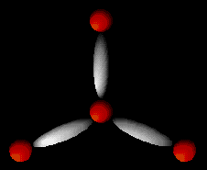
Common Molecular Shapes
3 total
3 bond
0 lone
B
A
B
B
BF₃
TRIGONAL PLANAR
120°
Courtesy Christy Johannesson www.nisd.net/communicationsarts/pages/chem

Slide 73
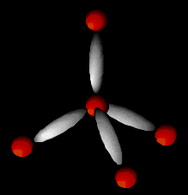
Common Molecular Shapes
4 total
4 bond
0 lone
B
A
B
B
B
CH₄
TETRAHEDRAL
109.5°
Courtesy Christy Johannesson www.nisd.net/communicationsarts/pages/chem

Slide 74
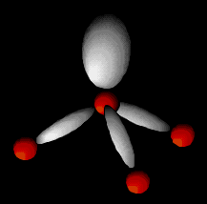
Common Molecular Shapes
4 total
3 bond
1 lone
NH₃
TRIGONAL PYRAMIDAL
107°
Courtesy Christy Johannesson www.nisd.net/communicationsarts/pages/chem

Slide 75
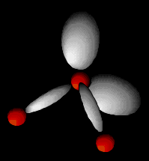
Common Molecular Shapes
4 total
2 bond
2 lone
H₂O
BENT
104.5°
Courtesy Christy Johannesson www.nisd.net/communicationsarts/pages/chem

Slide 76
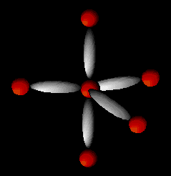
Common Molecular Shapes
Bª
5 total
5 bond
0 lone
B^{e}
A
B^{e}
B^{e}
Bª
PCl₅
TRIGONAL BIPYRAMIDAL
120°/90°
Courtesy Christy Johannesson www.nisd.net/communicationsarts/pages/chem

Slide 77
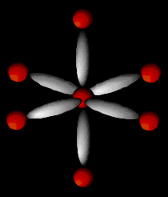
Common Molecular Shapes
6 total
6 bond
0 lone
B
B
A
B
B
B
B
SF₆
OCTAHEDRAL
90°
Courtesy Christy Johannesson www.nisd.net/communicationsarts/pages/chem

Slide 78
Examples
F P F
F
PF₃
4 total
3 bond
1 lone
TRIGONAL PYRAMIDAL
107°
Courtesy Christy Johannesson www.nisd.net/communicationsarts/pages/chem

Slide 79
Examples
O C O
CO₂
2 total
2 bond
0 lone
LINEAR
180°
Courtesy Christy Johannesson www.nisd.net/communicationsarts/pages/chem

